Slide 1
Employee Data Analysis using Excel
STUDENT NAME: SRIMATHI. G
REGISTER NO: 122204059/ asunm1659122204059
DEPARTMENT: BCOM (CORPORATE SECRETARYSHIP)
COLLEGE: SHRI KRISHNASWAMY COLLEGE FOR WOMEN

Slide 2
PROJECT TITLE
Employee Gender Analysis using Excel

Slide 3


AGENDA
Problem Statement
Project Overview
End Users
Our Solution and Proposition
Dataset Description
Modelling Approach
Results and Discussion
Conclusion
3/21/2024 Annual Review

Slide 4

PROBLEM STATEMENT
Gender in Companies is important for various reasons. Firstly, it helps in promoting Diversity and inclusion within the workplace. By understanding the gender composition of the workforce, companies can implement initiatives to ensure equal opportunities for all employees, regardless of gender.

Slide 5

PROJECT OVERVIEW
.
Identifying gender in companies plays a crucial role in fostering diversity and inclusivity within the workplace. By collecting and analyzing gender data, organizations can gain insights into the composition of their workforce, enabling them to create a more equitable environment for all employees. This information helps in addressing any gender imbalances, promoting equal opportunities, and developing targeted initiatives to support the professional growth and well-being of individuals of all genders.

Slide 6

WHO ARE THE END USERS?
Human resources department
Diversity and inclusion teams
Organizational leadership
Executives
Managers

Slide 7

OUR SOLUTION AND ITS VALUE PROPOSITION
Filter-remove
Pivot- summary
Graph- Data visualization

Slide 8
Dataset Description
Employees =Kaggle
9 Feature:
Employees I’d
Name = Text
Employees type
Performance level
Gender- male, Female
Employees rating- numerical

Slide 9

THE "WOW" IN OUR SOLUTION
By collecting and Analysing gender data, we can pinpoint areas for improvement, tailor initiatives to support gender equality, and foster a culture that values diversity.
This proactive approach not only enhances representation but also promotes equal opportunities and a supportive environment for individuals of all genders.
It's all about making a positive impact and driving positive change within the organization!
3/21/2024 Annual Review
9

Slide 10
MODELLING
1) Data collection:
In Edunet dash board downloading the data sets while using the kaggle data sets.
2) features:
identifying the employee ID
identifying employee names
identifying employee performance
identifying employee gender
3) data cleaning
identifying the missing value
filtering the missing value
4) gender analysis:
pivot table
separating the gender
graph -Data visualization
5)summary
Filter-remove
pivot-summary
graph-Data visualization
10

Slide 11
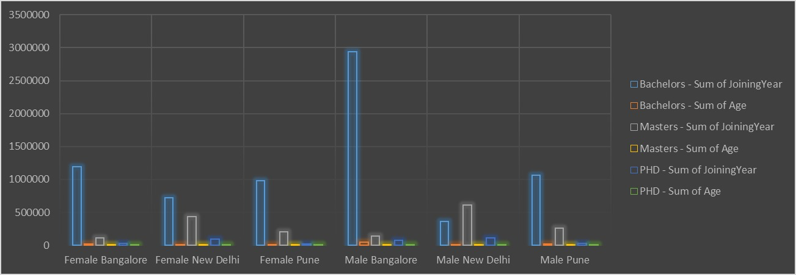
RESULTS
11

Slide 12
conclusion
it plays a vital role in promoting diversity, inclusion, and equality within the workplace. By collecting and analyzing gender data, organizations can implement targeted initiatives, address disparities, and create a more supportive environment for all employees.It's all about building a workplace where everyone feels valued, respected, and empowered to succeed.

